Slide 1



PIZZA SALES ANALYSIS
BY- SNEHA GUPTA

Slide 2
BACKGROUND
The organization currently relies on an on-premise MySQL Server database to store critical business data. However, there is a need for a more scalable, accessible, and secure data platform to support growing data volumes and advanced analytics requirements.

Slide 3
PROJECT GOALS
Migrate the on-premise MySQL Server database to Azure Data Lake Storage Gen2 for improved scalability and accessibility.
Establish a robust data ingestion pipeline using Azure Data Factory to efficiently transfer data from MySQL Server to Azure Data Lake.
Implement data transformation processes using Azure Databricks and PySpark to clean, enrich, and prepare data for analysis.
Create interactive and informative dashboards using Power BI to visualize key metrics and trends for business users.

Slide 4
DISCUSSION
By successfully executing this project, the organization will gain a centralized data platform capable of handling increasing data volumes, improving data quality, and enabling data-driven decision-making. The migration to Azure will enhance data security, scalability, and accessibility. Additionally, the integration of Azure Databricks and Power BI will provide powerful tools for data analysis and visualization.

Slide 5
TECHNICAL CHALLENGES
Efficiently migrating large datasets from on-premise MySQL Server to Azure Data Lake Storage Gen2.
Designing and implementing robust data transformation pipelines using PySpark and Spark SQL on Azure Databricks.
Ensuring data quality and consistency throughout the data ingestion and transformation processes.
Creating interactive and informative dashboards using Power BI to effectively communicate insights to business users.

Slide 6








END-TO-END DATA FLOW

Slide 7
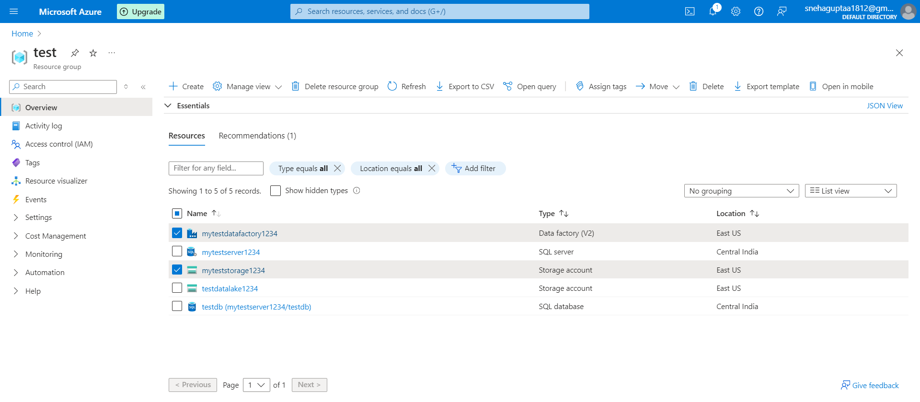

Slide 8
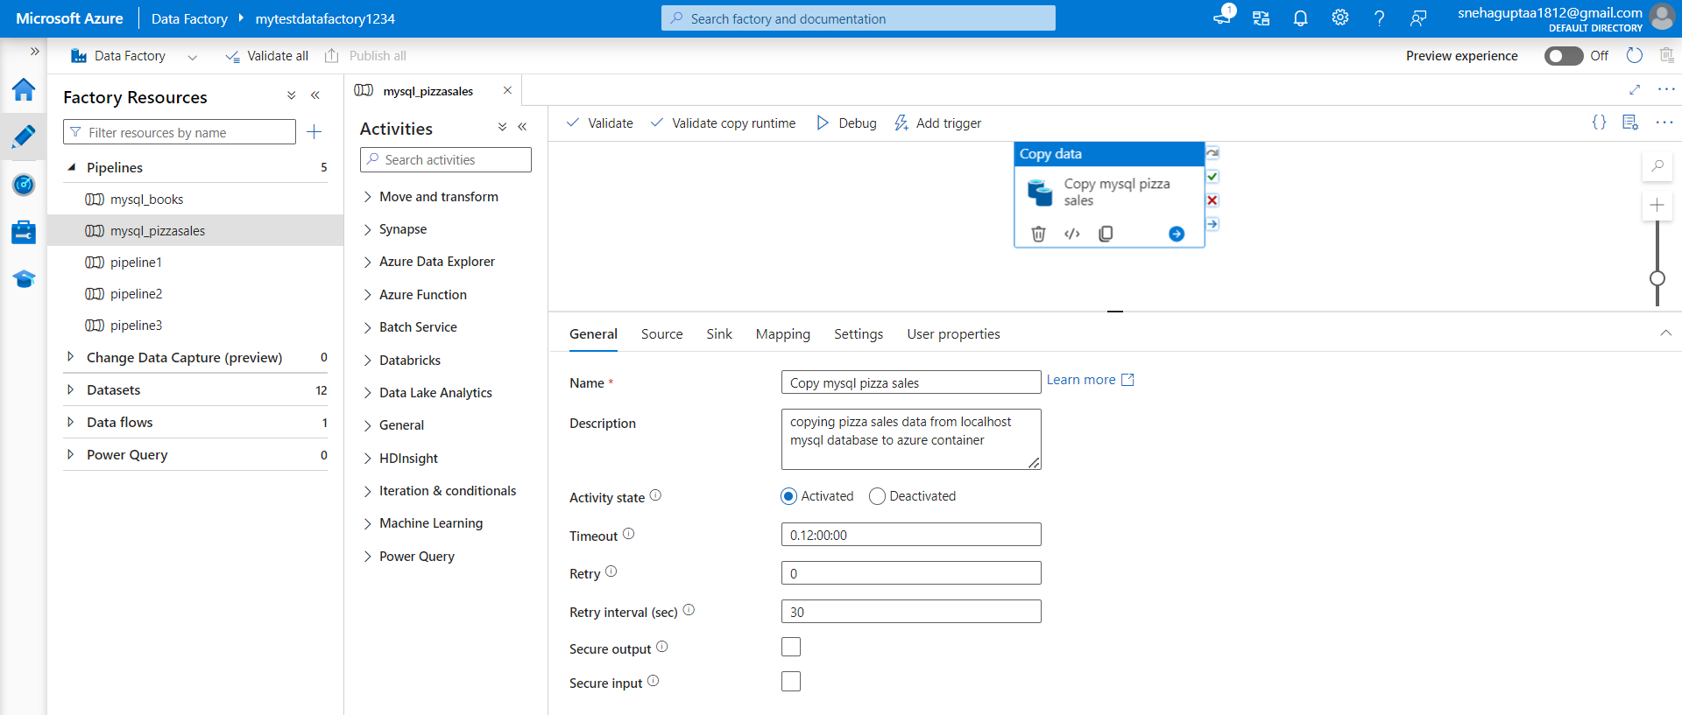

Slide 9
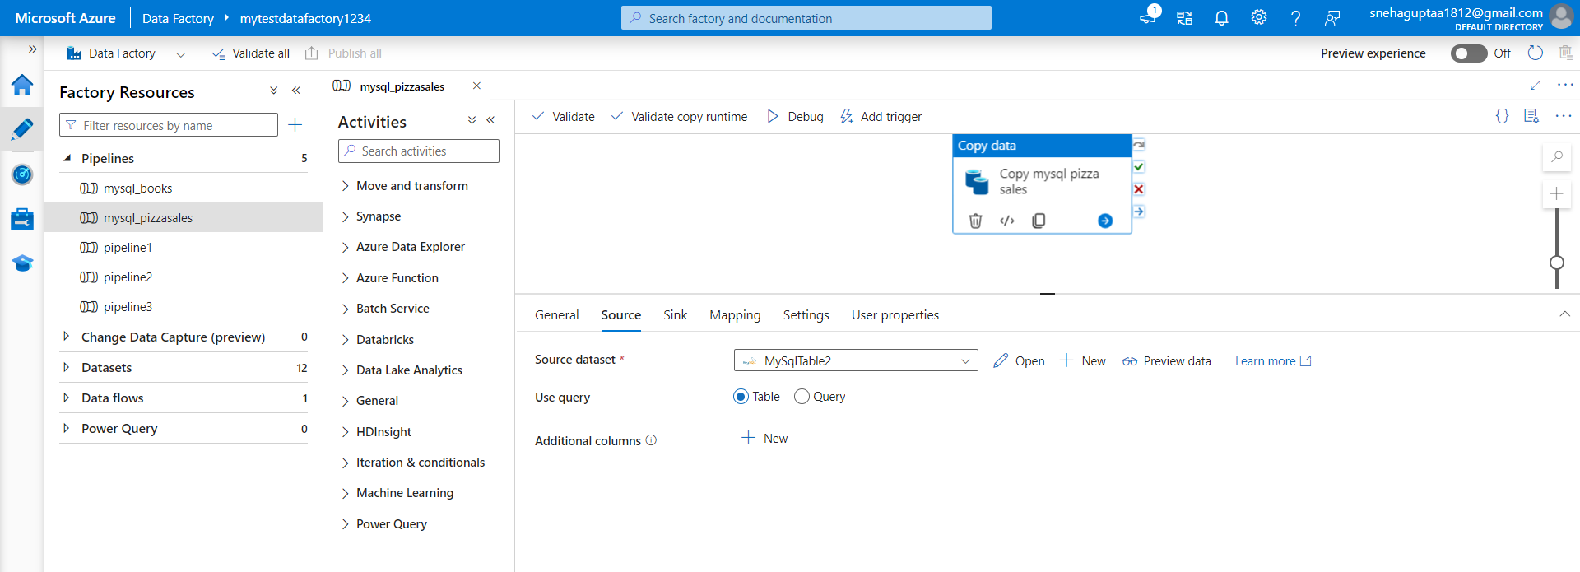

Slide 10
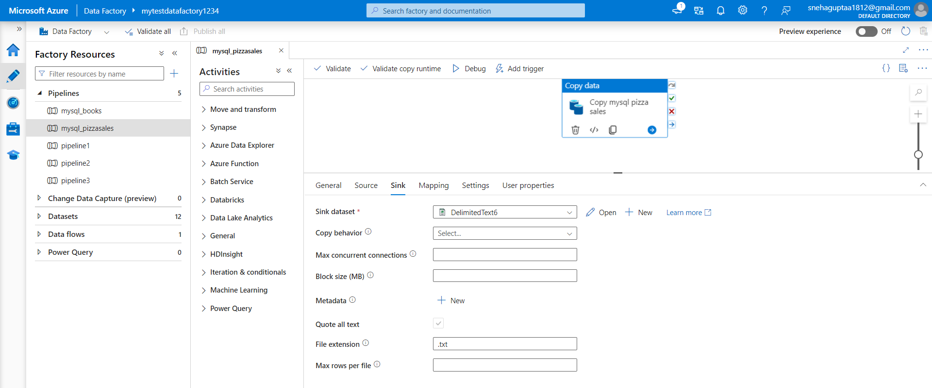

Slide 11
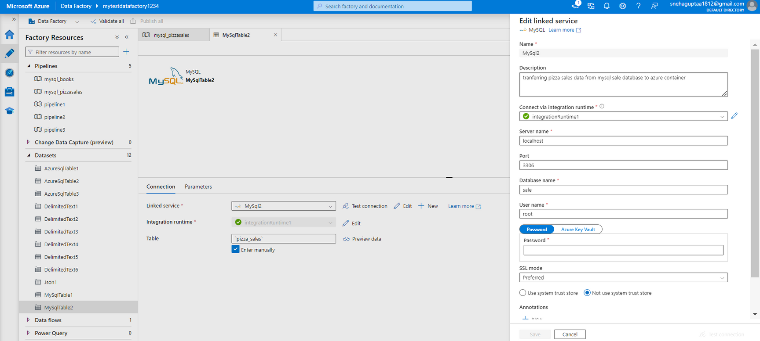

Slide 12
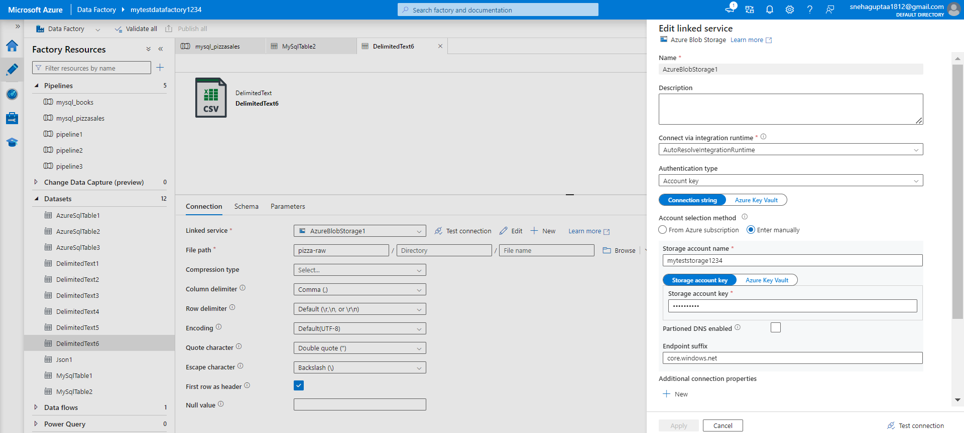

Slide 13
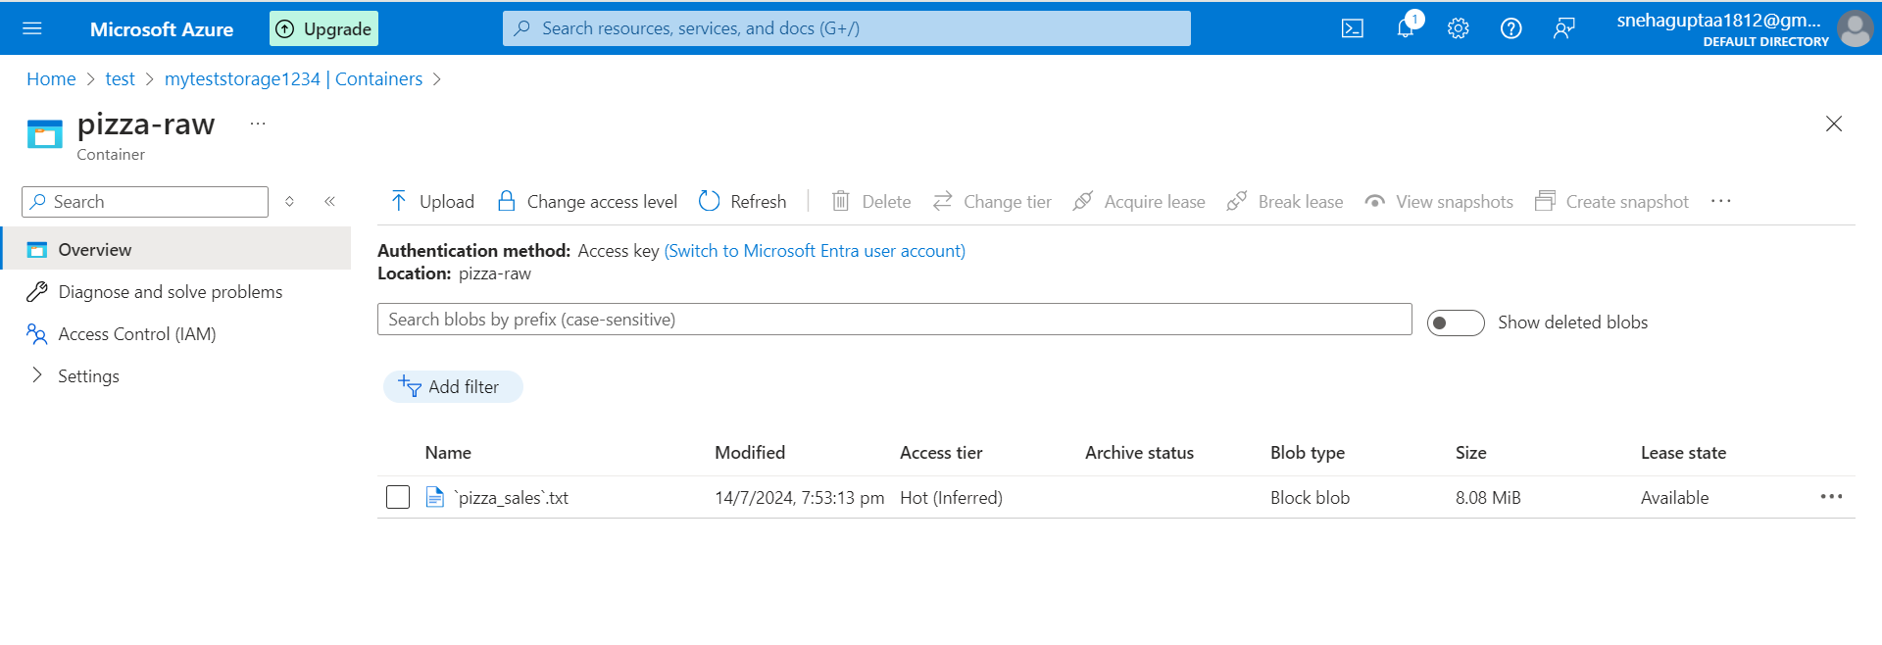

Slide 14
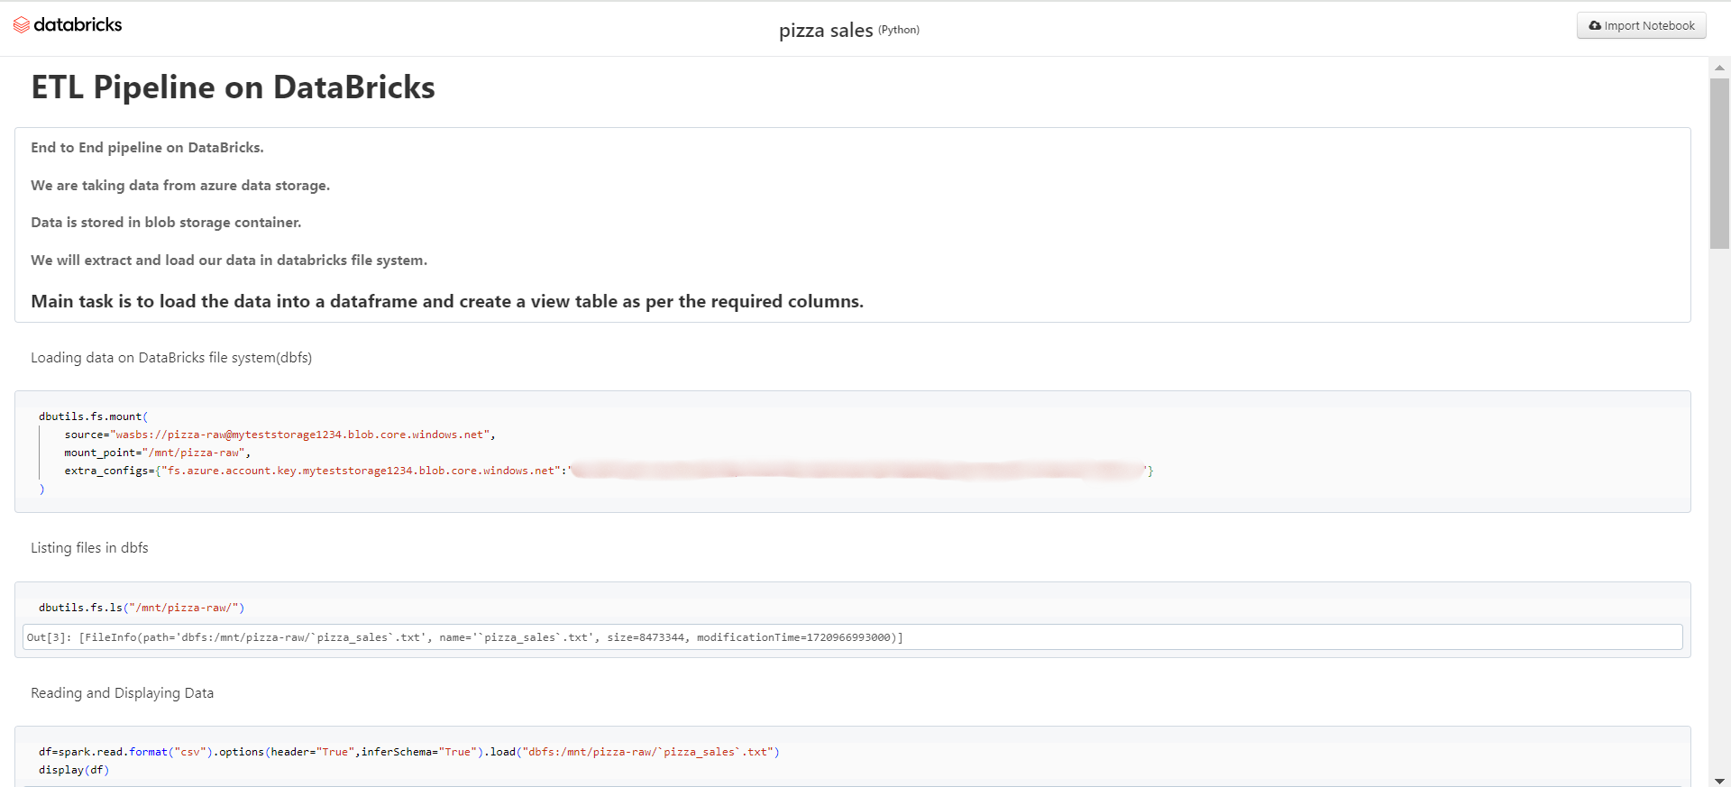
DATABRICKS

Slide 15
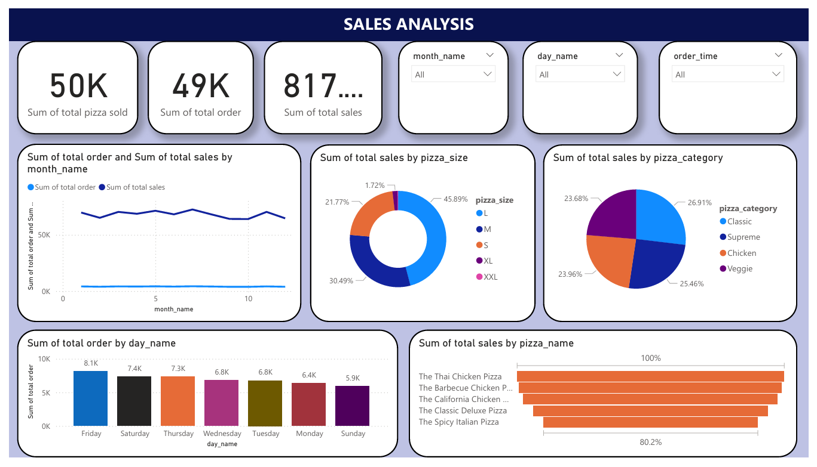
POWERBI ANALYSIS

Slide 16
CONCLUSION
Data Quality: The data ingestion and transformation processes successfully produced high-quality data for analysis.
Pipeline Performance: The data pipeline is efficient and scalable to handle increasing data volumes.
Data Insights: The analysis uncovered valuable insights that can inform business decisions.
Dashboard Effectiveness: The dashboard effectively communicates key insights to end-users.

Slide 17
THANK YOU

